Slide 1

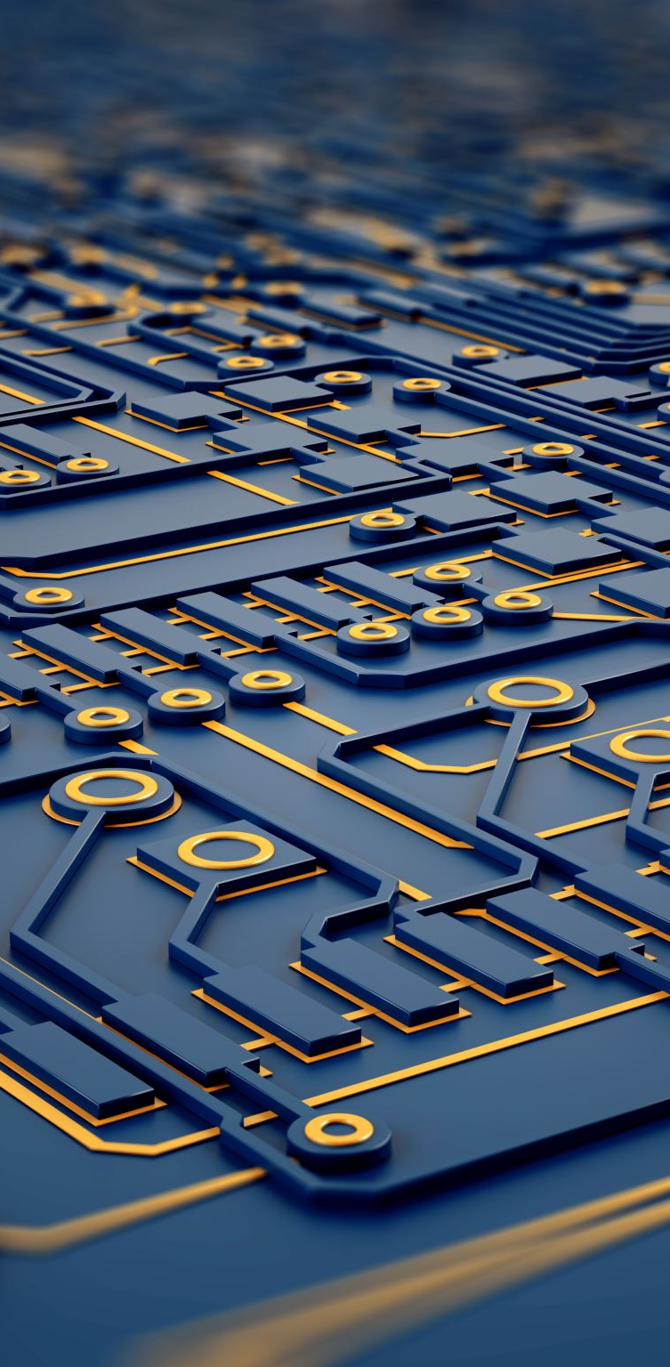
Computer Fundamentals

Slide 2
What is Computer ?
Computer is an advanced electronic device that takes raw data as input from the user and
processes these data under the control of set of instructions (called program) and gives
the result (output) and saves output for the future use. It can
process both numerical and
non-numerical (arithmetic and logical) calculations.
A computer has four functions:
a. accepts data:-
b. processes data:-
c. produces output:-
d. stores results:-
Input Processing Output Storage

Slide 3
Input (Data):
Input is the raw information entered into a computer from the input devices. It is the Collection of letters, numbers, images
Process:
Process is the operation of data as per given instruction. It is totally internal process of the computer system.
Output:
Output is the processed data given by computer after data pr- ocessing. Output is also called as Result. We can save these results in the storage devices for the future use.

Slide 4
Computer System
All of the components of a computer system can be summarized with the simple
equations.
COMPUTER SYSTEM = HARDWARE + SOFTWARE+ USER
Hardware = Internal Devices + Peripheral Devices
All physical parts of the computer (or everything that we can touch) are known as
Hardware.
Software = Programs
Software gives "intelligence" to the computer.
USER = Person, who operates computer.

Slide 5
Digital and Analog Computers
A digital computer uses distinct values to represent the data internally. All information are represented using the digits 0s and 1s. The computers that we use at our homes and offices are digital computers.
Analog computer is another kind of a computer that represents data as variable across a continuous range of values. The earliest computers were analog computers.
Analog computers are used for measuring of parameters that
vary continuously in real time, such as temperature, pressure and voltage. Analog computers may be more flexible but generally less precise than digital computers. Slide rule is an example of an analog computer.
This book deals only with the digital computer and uses the
term computer for them.

Slide 6
Characteristics of Computer/Advantages
Speed, accuracy, diligence, storage capability and versatility are some of the key characteristics of a computer. A brief overview of these characteristics are
Speed:- The computer can process data very fast, at the rate of millions of instructions per second. Some calculations that would have taken hours and days to complete otherwise, can be completed in a few seconds using the computer. For example, calculation and generation of salary slips of thousands of employees of an organization, weather forecasting that requires analysis of a large amount of data related to temperature, pressure and humidity of various places, etc.
Accuracy:- Computer provides a high degree of accuracy.
For example, the computer can accurately give the result of division of any two numbers up to 10 decimal places.

Slide 7
Diligence:- When used for a longer period of time, the computer does not get tired or fatigued. It can perform long and complex calculations with the same speed and accuracy from the start till the end.
Storage Capability:- Large volumes of data and information can be stored in the computer and also retrieved whenever required. A limited amount of data can be stored, temporarily, in the primary memory. Secondary storage devices like floppy disk and compact disk can store a large amount of data permanently.
Versatility:- Computer is versatile in nature. It can perform
different types of tasks with the same ease. At one moment you can use the computer to prepare a letter document and in the next moment you may play music or print a document.

Slide 8
Automation:-
Computer is a automatic machine.
Automation means ability to perform the task automatically.
Once a program is given to computer i.e. stored in computer memory, the program and instruction can control the program execution without human interaction.
Reduction in Paper Work:-
The use of computers for data processing in an organization leads to reduction in paper work and speeds up the process.
As data in electronic files can be retrieved as and when
required, the problem of maintenance of large number of files gets reduced.

Slide 9
REDUCTION IN COST:-
Though the initial investment for installing a computer is high but it substantially reduces the cost of each of its transaction.

Slide 10
Disadvantages
Following list demonstrates the disadvantages of Computers in today's arena.
No i.q:-
A computer is a machine and has no intelligence of its own to perform any task.
Each and every instruction has to be given to computer.
A computer can not take any decision on its own.
Dependency:-
It can perform function as instructed by user.So it is fully dependent on human being.

Slide 11
Environment:-
The operating environment of computer should be dust free and suitable to it.
No Feeling:-
Computer has no feeling or emotions.
It cannot make Judgement based on feeling, taste, experience and knowledge unlike a human being.

